Slide 1


Network Mapping utility for visualizing and analyzing Large-scale Network Scans
Final Presentation
Technical Directors:
Celeste Matarazzo
Domingo Colon
Faculty Supervisor:
Dr. Ying Luo
Ghadir Alfadhl, Anthony Zito, Philip Zuehlke, and Cody Snoreck

Slide 2


Project Overview
Network port scans are a common aspect of enterprise security practices. As IP ranges can be huge and scan data can be large, new visual representations are needed to provide cyber defenders with better analysis capabilities of these scan results. The goal of this project is to explore approaches and to develop a prototype utility to improve on current mapping visualization capabilities.

Slide 3
Project Requirements
⬡Represent IP addresses scans in two dimensions.
⬡Capability to highlight port/service availability
⬡Represent thousands of IP addresses in a single screen
⬡Provide for annotation of target IP address blocks
⬡Ability to highlight changes between consecutive scans
⬡Keep nearby IP addresses physically near each other

Slide 4
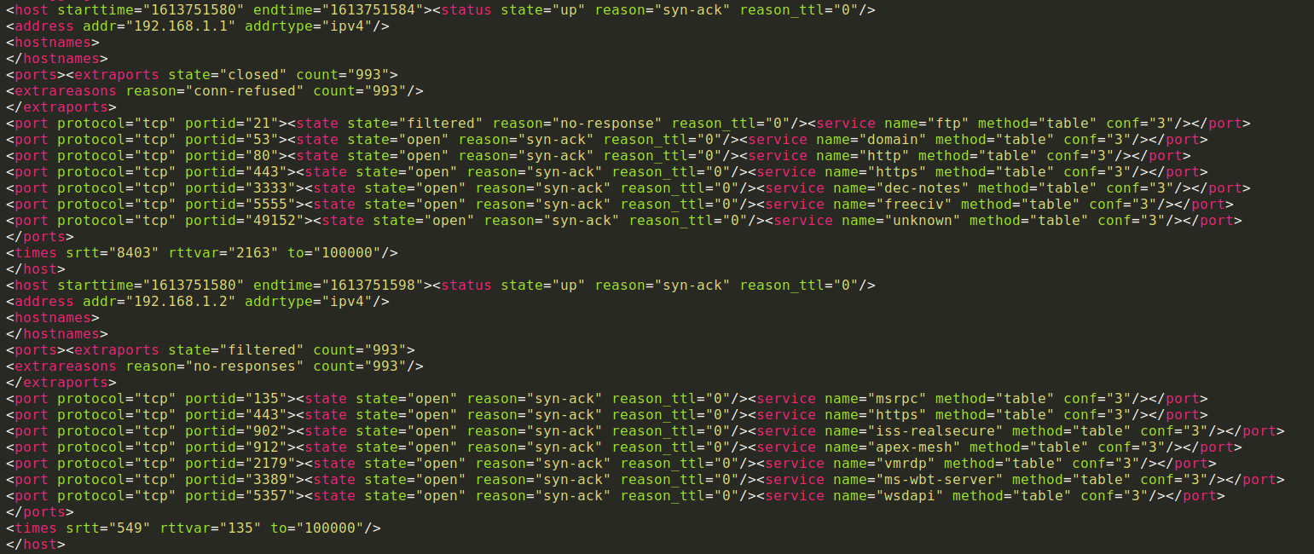
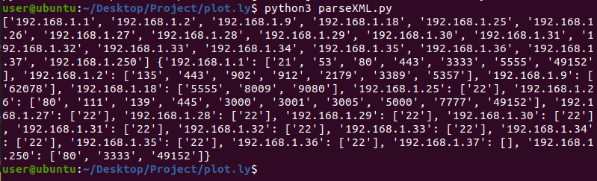
Old method -data parsing

Slide 5
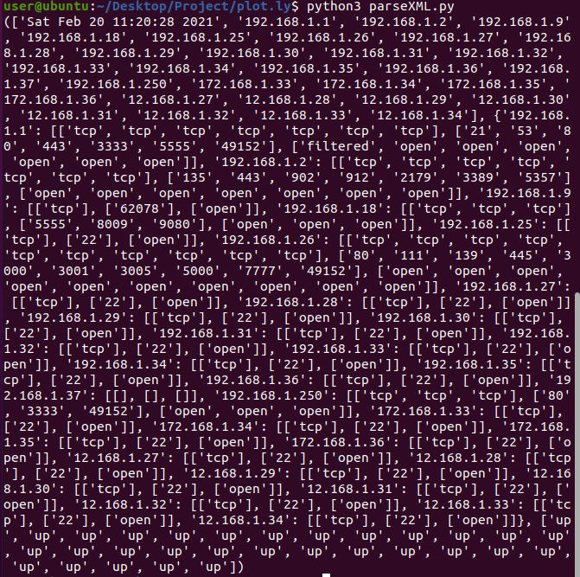
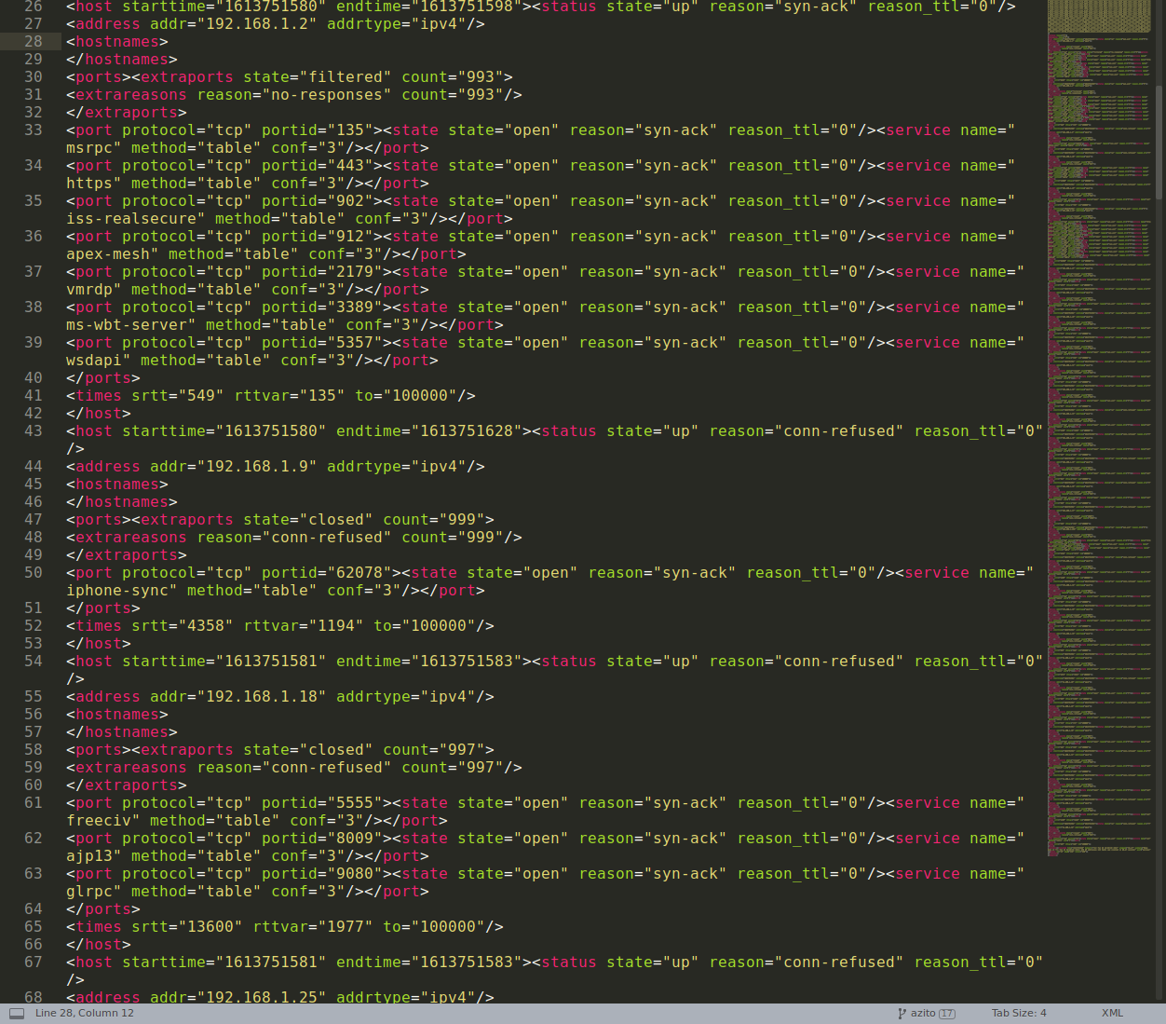
Data Parsing

Slide 6



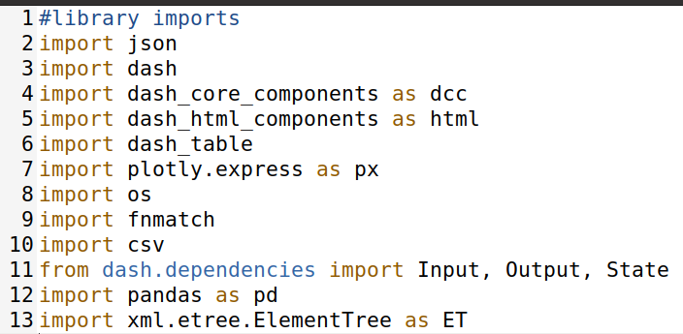

How we did it

Slide 7

Problems that we solved
Parsing through a .XML file using Python
How to visually represent IP addresses in a useful manner
Displaying port data
Obtaining Large scans
Historical Time Dating Scan for Port scan overview

Slide 8
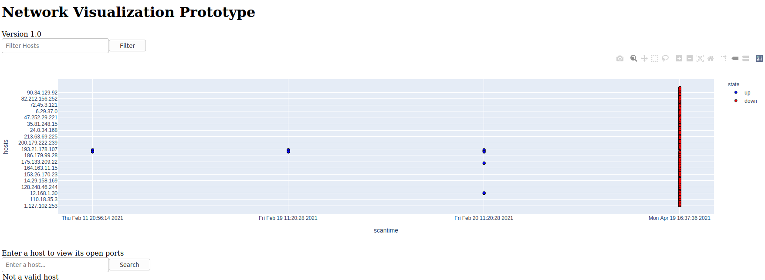

Slide 9
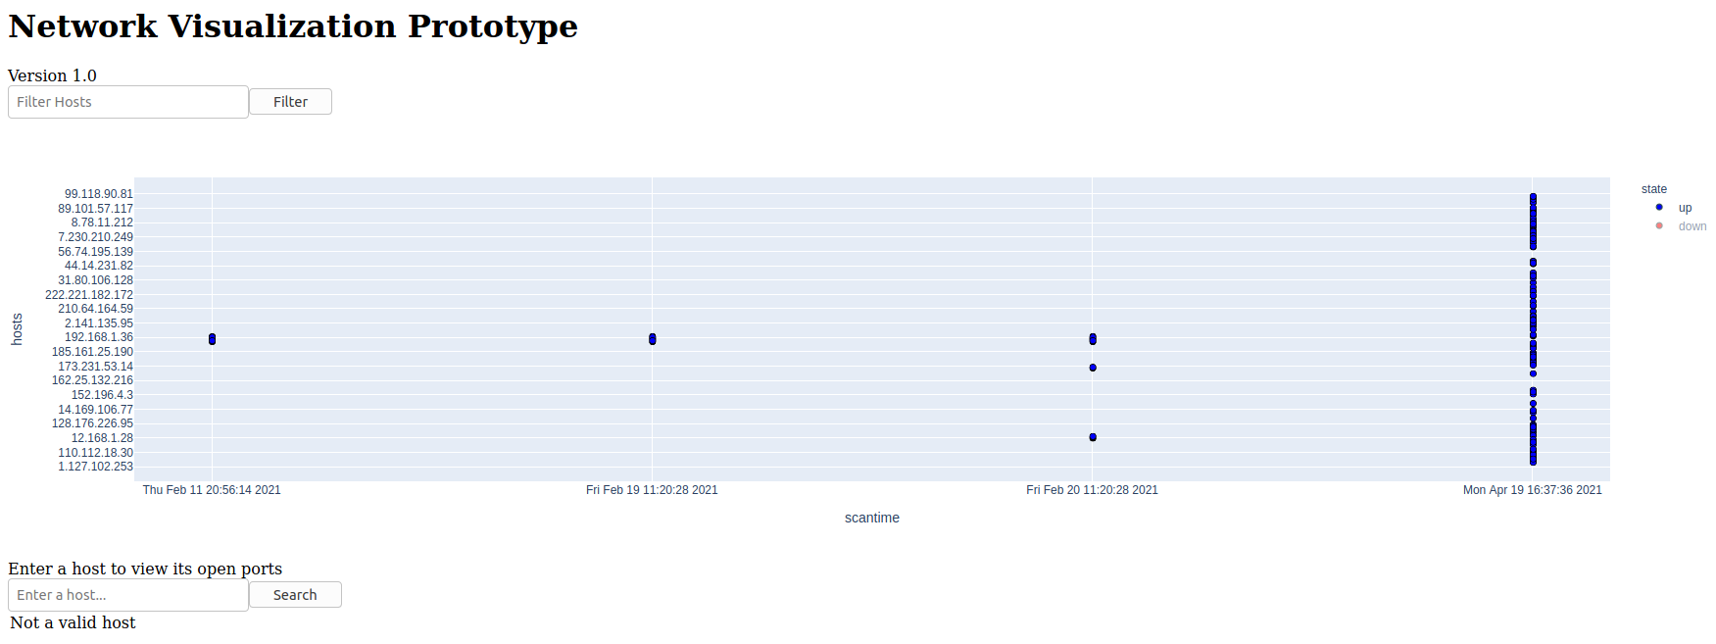

Slide 10
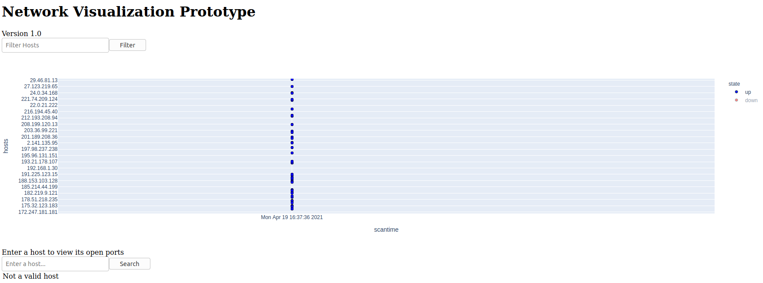

Slide 11
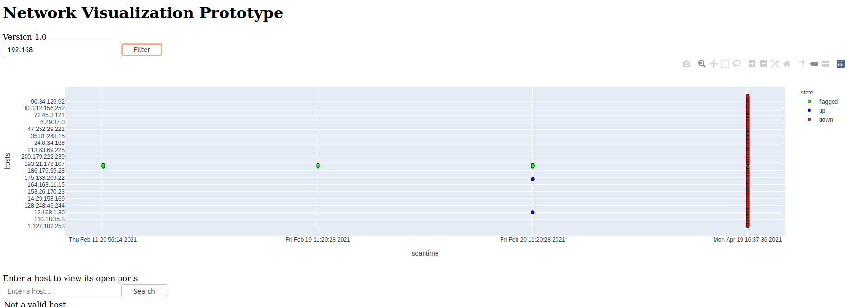

Slide 12
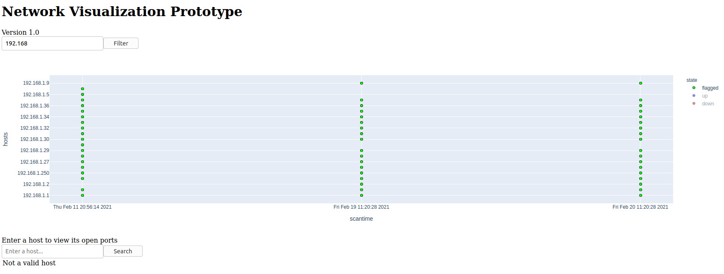
Ability to highlight changes between consecutive scans

Slide 13
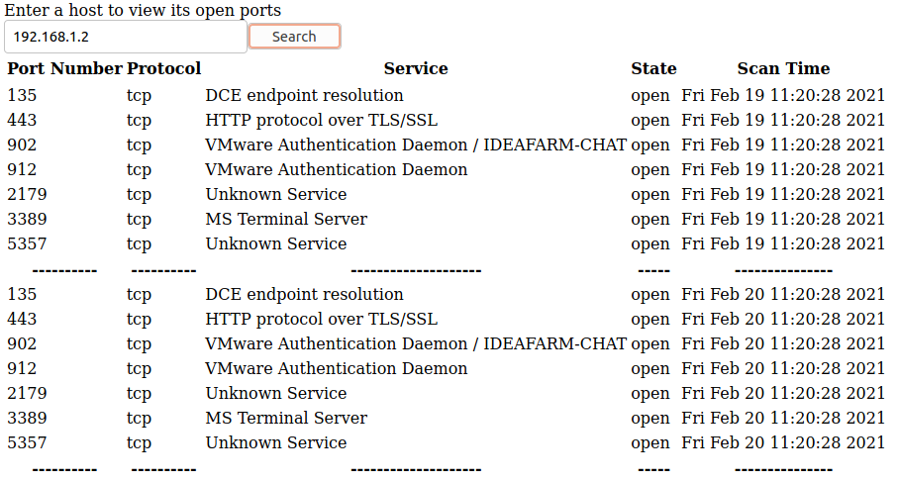
Capability to highlight port/service availability

Slide 14
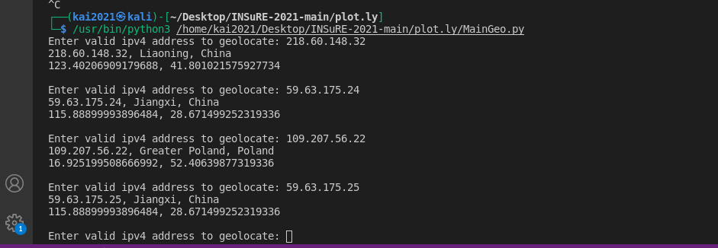
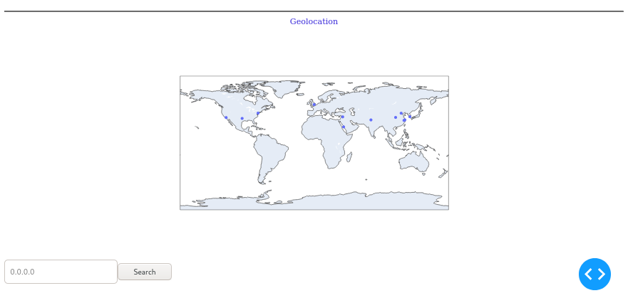
Current Implementation Problems
Geolocation

Slide 15
What could/should be done next?
Already done initial work on the geolocation, that print: region, country, longitude, latitude by running the code and entered the public ip address you want to know the geolocation for. It is done separately from the Prototype because only used internal IPs in our project.
The next step is to take the code that we used for the geolocation and then and put it together in the code for the Prototype. It should work as expected when scanning the external network.

Slide 16
Questions?

